Slide 1
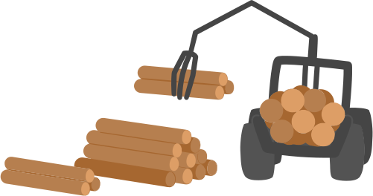

DEFORESTATION DETECTION
A pixel-wise anomaly detection algorithm that will contribute in in monitoring and preventing deforestation

Slide 2

CHALLENGE
Prepare a timeseries of pixel values from the satellite imagery
Implement version of Breaks For Additive Season and Trend (BFAST) method
Visualize the results

Slide 3

EXPLORING DATA
interview_area_brazil.geojson
Analyzed the data used folium
file:///C:/Users/theon/Downloads/brazil_map.html

Slide 4

BRAZIL DATA
Used features_brazil.npy
Shape of (72, 368, 420, 13)
72 time steps
368, 420 the height and width of the image
13 number of channels

Slide 5

13 CHANNELS
12 different bands of the satellite data and one quality band indicating the quality of the image
B01, B02, B03, B04, B05, B06, B07, B08, B8A, B09, B11, B12, SCL
https://sentiwiki.copernicus.eu/web/s2-applications
https://docs.sentinel-hub.com/api/latest/data/sentinel-2-l2a/

Slide 6
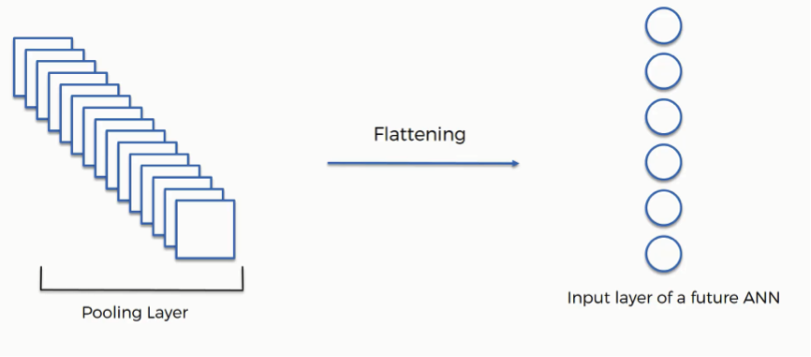
......
13 channels
index 0
index 1
index 71

Slide 7
Used RGB channel to visualize the images
B04 Red
B03 Green
B02 Blue

Slide 8
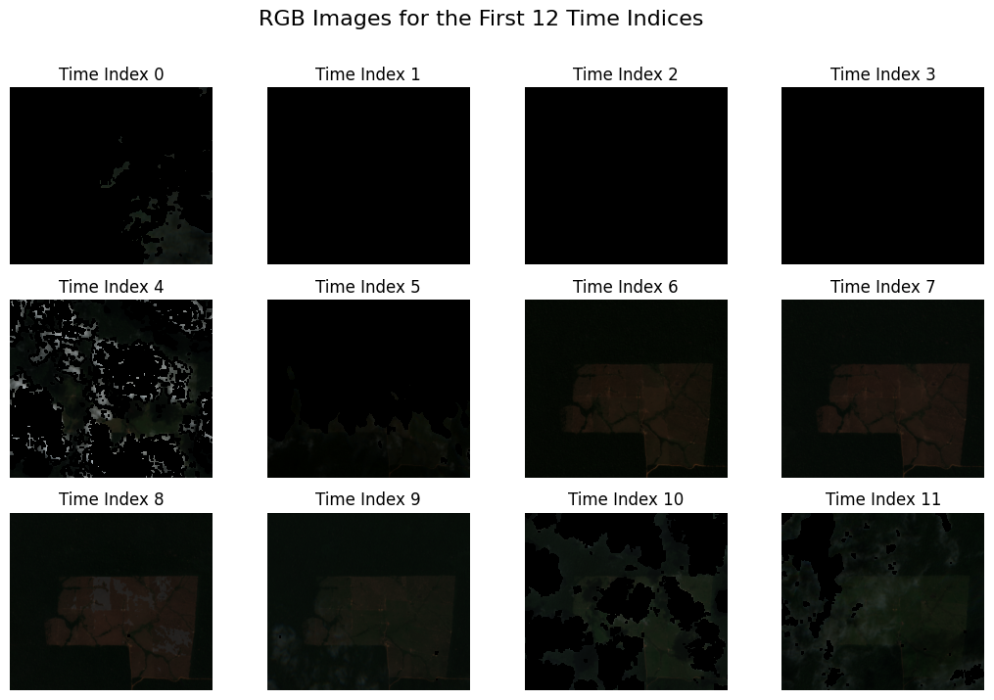

Slide 9
NORMALIZED BURN RATIO (NBR)
Used to identify burned areas and provide a measure of burn severity
Ratio between the NIR (near infrared) and SWIR (shortwave infrared) values
NBR = (NIR - SWIR) / (NIR + SWIR)
NBR = (Band 4 – Band 7) / (Band 4 + Band 7)
https://www.usgs.gov/landsat-missions/landsat-normalized-burn-ratio

Slide 10
Normalized Burn Ratio or NBR returns values between -1 and 1.
Positive NBR values indicates healthy green vegetation while while burnt vegetation will have a low value.

Slide 11
VISUALIZING PIXEL TIMESERIES
Considered a pixel with
row_index = 160
col_index = 215

Slide 12
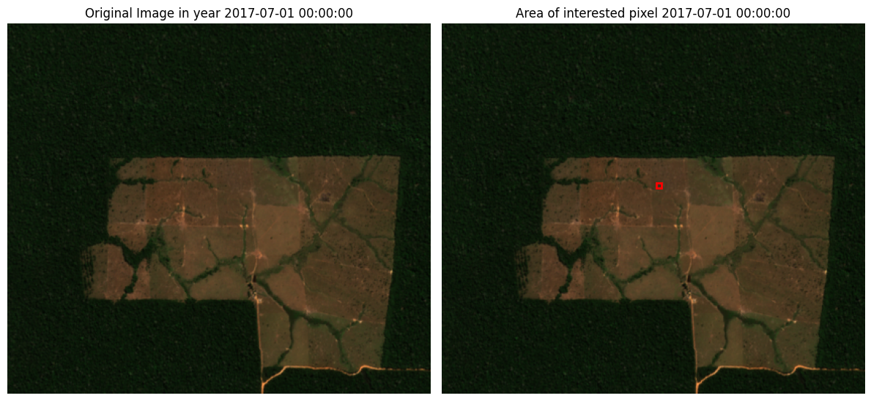

Slide 13
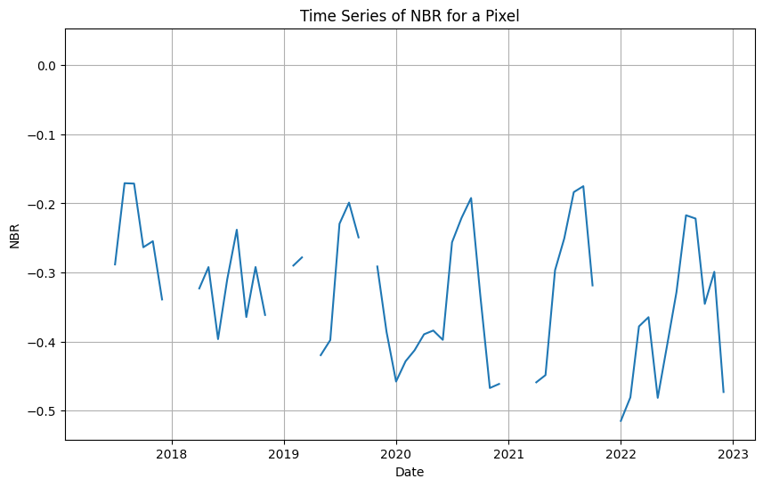

Slide 14
Value started to decline over the years meaning the vegetation was becoming BURNT or BROWN vegetation or BARE SOIL
A seasonality, the start of the year it is dry or brow vegetation but over the the months (mid year) it becomes greener.
This shows a possiblity of rain as discussed in https://en.wikipedia.org/wiki/Climate_of_Brazil

Slide 15
FITTING BFAST ALGO

Slide 16
BFAST ALGO
Uses additive season and trend model
Two periods:
History : Data acquired and analysed for stability
Monitoring: New data acquired and analyse for disturbance
https://bfast.r-forge.r-project.org/Verbesselt+Zeileis+Herold-2012.pdf

Slide 17
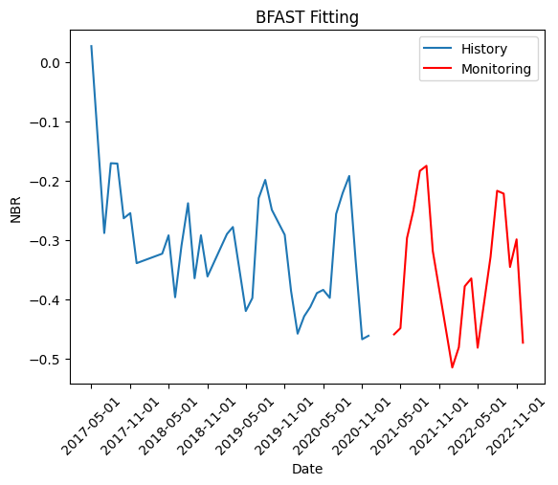

Slide 18
BFAST ALGO
During monitoring phase uses moving sum (MOSUM) of residuals
MOSUM has a sliding window h (h-hyperparameter )
MOSUM process is close to zero if model remains stable
MOSUM process deviates from zero if structural change occur
https://bfast.r-forge.r-project.org/Verbesselt+Zeileis+Herold-2012.pdf

Slide 19
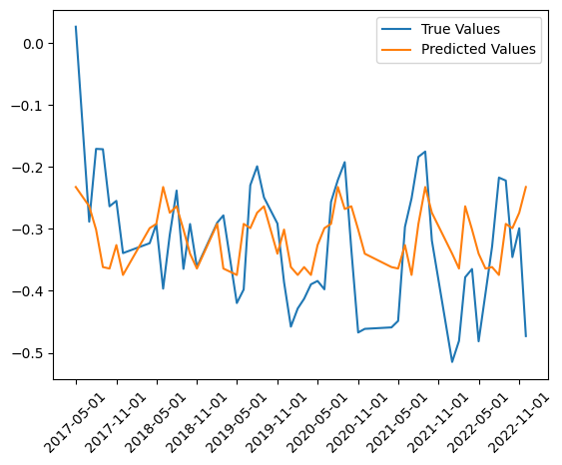
Case where
no break was detected

Slide 20
The next slide contains an example for break
nbr_data[:, 0, 306]

Slide 21
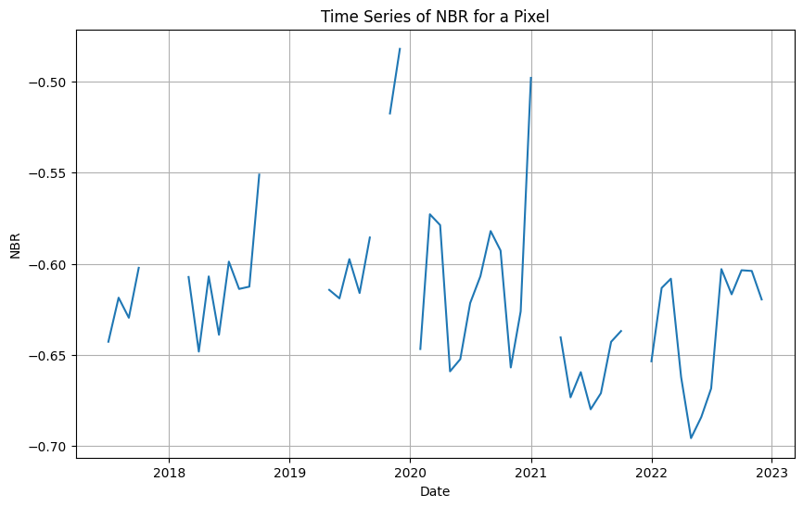

Slide 22
NBR value on which break is detected: -0.668
Date on which break is detected: 2022-07-01 00:00:00

Slide 23
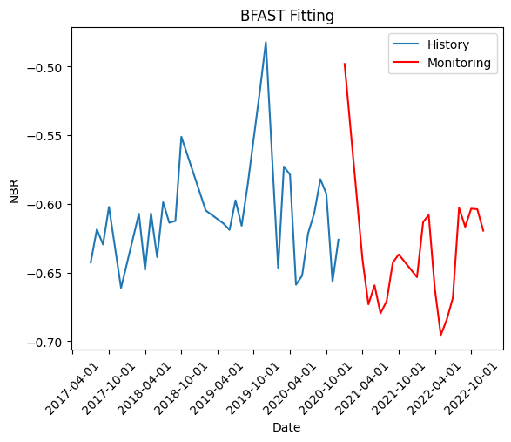


Slide 24
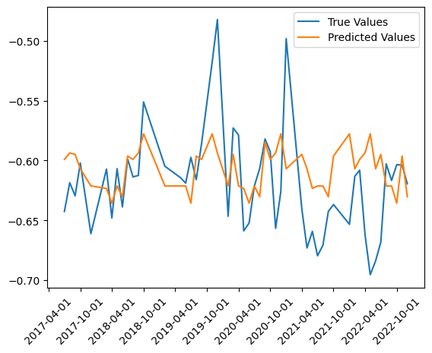

Slide 25
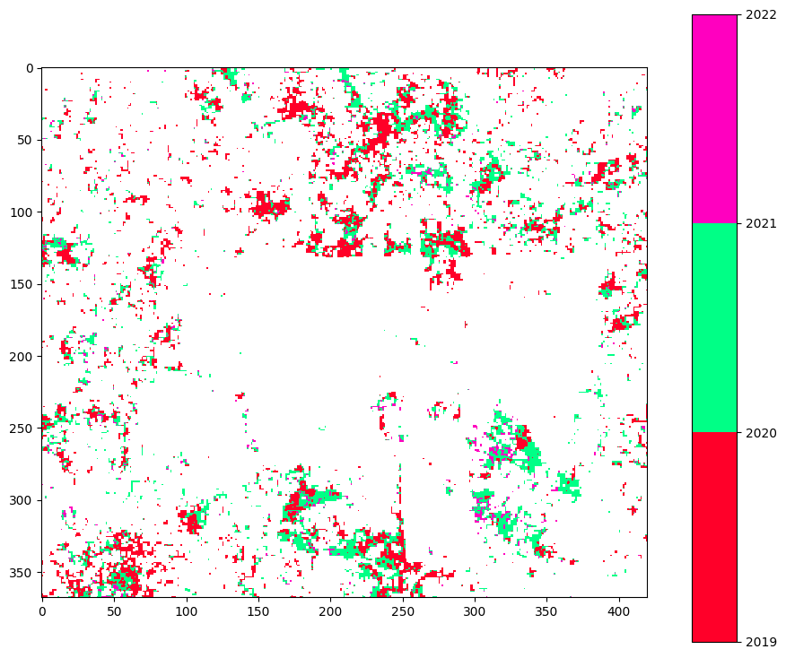
Started Monitoring from 2019 onwards

Slide 26

Challenges
Limited Data - model not able to fit
Hyperparameters
Labeled data to make deductions conclusive

Slide 27

Future Approaches
Additional information
Looking into the soil minerals or texture
Weather data
Handling nan values
Masking the value
Temporal Interpolation

Slide 28

THANK YOU

